Slide 1

1
2
3
4
Understanding Your Workforce’s Self-Directed Learning Capabilities
5
Colin Talbot
talbot.unt@gmail.com
Doctoral Student
University of North Texas
College of Information
Department of Learning Technologies
6
7
8

Slide 2






Presentation Overview
1
2
3
SDL Introduction
SDL Process
4
SRSSDL Instrument
Adapting SRSSDL
5
6
Future Studies & Implications
Current Study
7
8

Slide 3
SDL Introduction
1
2
SDL
Elements
Benefits
Needs
Gaps
3
01
02
03
04
05
4
Self-Directed Learning is difficult to narrow into a singular definition.
Common Dimensions
Not in a formal education setting
Learners select an environment that allows them to take responsibility
Learner Decisions
Goal Development
SDL research picked up in the 1970s and 1980s and has continued on today.
Long (1989)
Social Isolation
Independence – pedagogical
Self-direction
Candy (1991)
Balance between the learner and institution
Brockett & Hiemstra (2018)
Personal responsibility
Learner growth and development within an organization.
Dynamic Capabilities – the ability to integrate and reconfigure resources to match a changing environment
Knowledge Management – the ability to create, curate, and share knowledge across the organization or industry
SDL is a growing trend for many organizations as a method for employee growth and development.
Growing knowledge demand and technological changes / advancement
Growing demands and challenges for organizations
Formal L&D teams cannot meet the learning needs of the workforce
What is missing in the workplace when it comes to SDL?
Examination of how organizations can support learners in managing both their role and learning responsibilities
Understanding their workforce's SDL skills and how to support them.
Instrument to identify skill gaps for high knowledge fields.
5
6
7
(Lemmetty & Collin, 2020) (Raemdonck et al., 2014)
(Noe et al., 2014)
(Raemdonck et al., 2014)
(Robinson & Persky, 2020)
(Loeng, 2020)
(Shih-Yi & Ching-Han, 2012)
(Chuang, 2004)
8

Slide 4
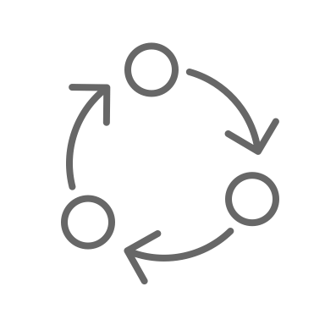
SDL Process
1
2
3
Diagnosing Learning Needs
4
Evaluating Learning Outcomes
Developing Learning Goals
5
Self-Directed Learning Process
(Knowles, 1975)
6
Implementing Learning Strategies
Identifying Resources
7
8

Slide 5





SRSSDL Instrument
1
Awareness
& Learning Strategies
2
Self-Rating Scale of Self-Directed Learning (SRSSDL) consists of 60 questions separated into 5 sections. Originally developed for higher education, and adapted to use in the healthcare sector.
Diagnosing Learning Needs
Evaluating Learning Outcomes
Developing Learning Goals
Awareness
SRSSDL
Learning Activities
3
Learning Strategies
Implementing Learning Strategies
Identifying Resources
(Williamson, 2005) (Williamson et al., 2017)
Evaluation
4
5
01
02
03
04
05
6
Awareness
Learning Strategies
Learning Activities
Evaluation
Interpersonal Skills
7
8
12 Questions
12 Questions
12 Questions
12 Questions
12 Questions

Slide 6
Adapting the SRSSDL for the Workplace
1
2
The Delphi Method was utilized to adapt the questions in each section to apply to the general workplace. The team of reviewers were 10 PhD faculty and students who all work full time in high knowledge demand industries
I am responsible for identifying my areas of deficit.
I am responsible for identifying my own learning needs.
I am responsible for identifying my own knowledge deficits.
3
I find learning from case studies useful.
I find case studies useful for learning.
I identify the important points when reading a chapter or article.
I can identify important points when presented with new material.
4
(Linstone & Turoff, 1975)
I value criticism as the basis of bringing improvement to my learning.
I value feedback from my work to direct my learning.
I am successful in communicating verbally.
I can talk about the impact of my learning.
5
6
01
02
03
04
05
Awareness
Learning Strategies
Learning Activities
Evaluation
Interpersonal Skills
7
8
12 Questions
12 Questions
12 Questions
14 Questions
12 Questions

Slide 7
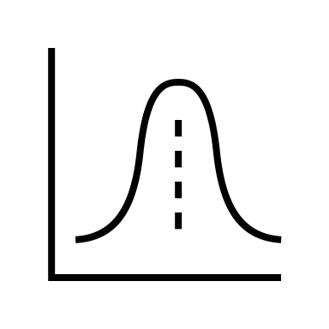

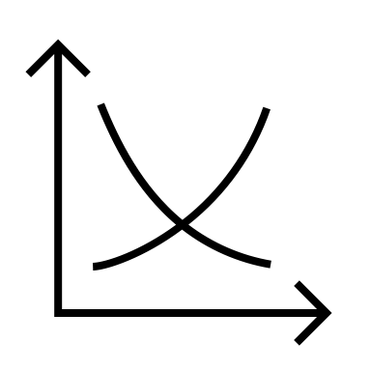

Current Study
1
2
3
4
Reliability
5
Updated SRSSDL
Test Population
Analysis
Workplace SRSSDL
6
7
Validity
8

Slide 8
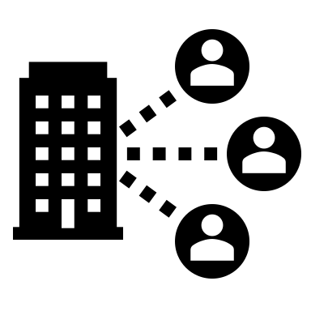
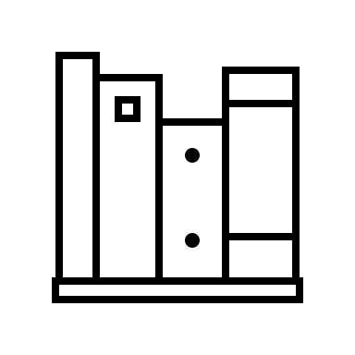
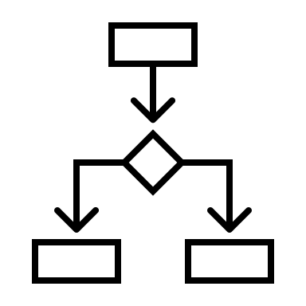
Future Studies & Implications
1
2
01
02
03
3
Workplace Deployment
Guide Development of Resources
Intervention Study
4
5
Use the Workforce SRSSDL within organizations to determine the SDL skillset.
Use results from the Workplace SRSSDL to develop resources and programs to support SDL skill development.
Conduct an intervention study utilizing the Workplace SRSSDL in conjunction with developed resources to determine potential impact.
6
7
8

Slide 9
Future Studies & Implications
1
2
3
4
SRSSDL
Organizational Support
5
6
7
8

Slide 10
Future Studies & Implications
1
Organizational Priorities
Challenge
2
Knowledge Management
3
Challenge
Organizational Support
4
Challenge
5
Learner Priorities
Dynamic Capabilities
6
7
8

Slide 11
References
1
Brockett, R. G., & Hiemstra, R. (2018). Self-direction in adult learning: Perspectives on theory, research, and practice. Routledge.
Candy, P. C. (1991). Self-Direction for Lifelong Learning. A Comprehensive Guide to Theory and Practice. Jossey-Bass, 350 Sansome Street, San Francisco, CA 94104-1310.
Chuang, S. H. (2004). A resource-based perspective on knowledge management capability and competitive advantage: an empirical investigation. Expert systems with applications, 27(3), 459-465. https://doi.org/10.1016/j.eswa.2004.05.008.
Knowles, M. S. (1975). Self-directed learning: A guide for learners and teachers.
Lemmetty, S., & Collin, K. (2020). Self-directed learning as a practice of workplace learning: Interpretative repertoires of self-directed learning in ICT work. Vocations and Learning, 13(1), 47-70.https://doi-org.libproxy.library.unt.edu/10.1007/s12186-019-09228-x
Linstone, H. A., & Turoff, M. (1975). The Delphi method : techniques and applications. Addison-Wesley Pub. Co., Advanced Book Program.
Loeng, S. (2020). Self-directed learning: A core concept in adult education. Education Research International, 2020.
Long, H. B. (1989). Self-Directed Learning: Emerging Theory & Practice. Oklahoma Research Center for Continuing Professional and Higher Education, McCarter Hall, University of Oklahoma, Norman, OK 73037.
Noe, R. A., Clarke, A. D., & Klein, H. J. (2014). Learning in the twenty-first-century workplace. Annual review of organizational psychology and organizational behavior, 1(1), 245-275.
Raemdonck, I., Gijbels, D., & Van Groen, W. (2014). The influence of job characteristics and self‐directed learning orientation on workplace learning. International Journal of Training and Development, 18(3), 188-203. https://doi-org.libproxy.library.unt.edu/10.1111/ijtd.12028
Robinson, J. D., & Persky, A. M. (2020). Developing self-directed learners. American Journal of Pharmaceutical Education, 84(3).
Shih-Yi, C., & Ching-Han, T. (2012). Dynamic capability, knowledge, learning, and firm performance. Journal of Organizational Change Management, 25(3), 434-444. https://doi-org.libproxy.library.unt.edu/10.1108/09534811211228148
Williamson, S. N. (2005). The development of a self-rating scale of self-directedness in learning (SRSSDL) for students of higher education.
Williamson, Swapna Naskar, and Mahesh Seewoodhary. "Student evaluation of the usefulness of the Self-Rating Scale of Self-Directed Learning tool in the FdSc in Health and Social Care Course." Journal of Healthcare Communications 2, no. 4 (2017).
2
3
4
5
6
7
Thank You!
8

Slide 12
1
2
3
4
Questions?
5
Colin Talbot
talbot.unt@gmail.com
Doctoral Student
University of North Texas
Department of Learning Technologies
6
7
8

Slide 13
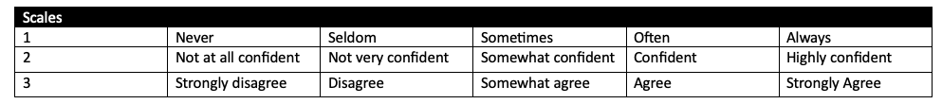
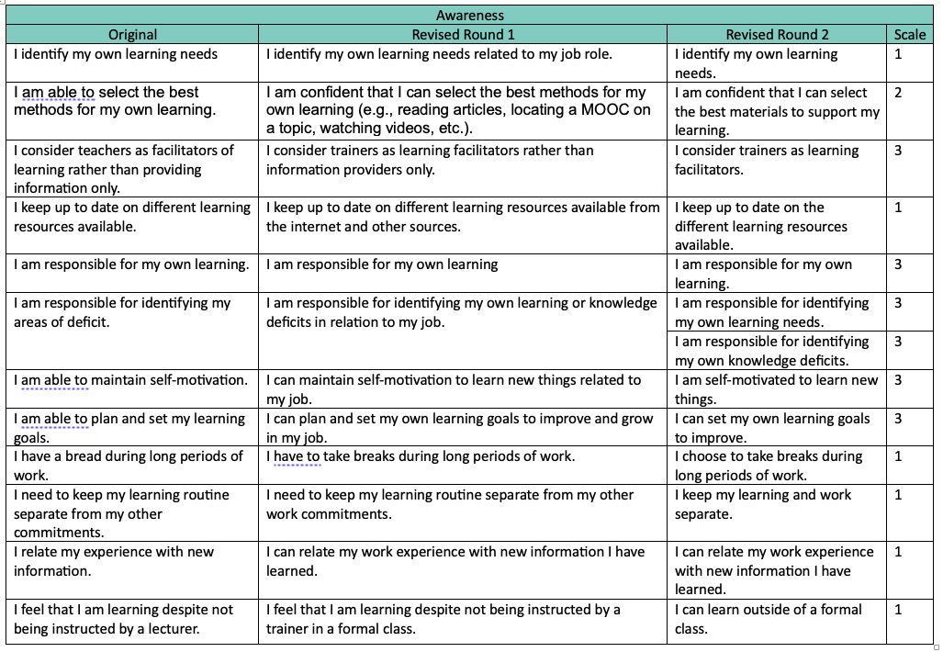
1
2
3
4
5
6
7
8

Slide 14
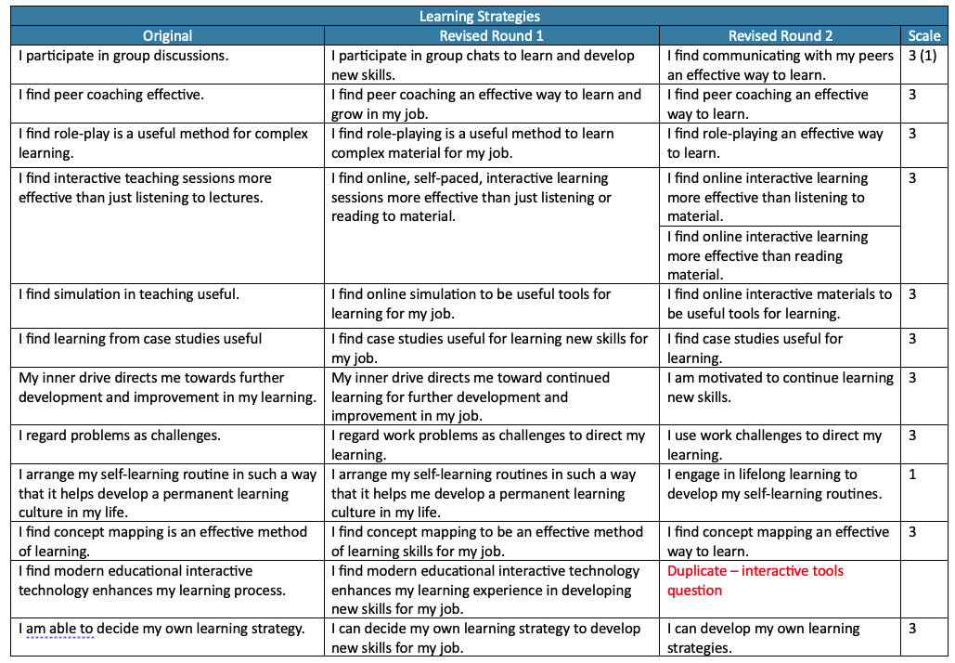
1
2
3
4
5
6
7
8

Slide 15
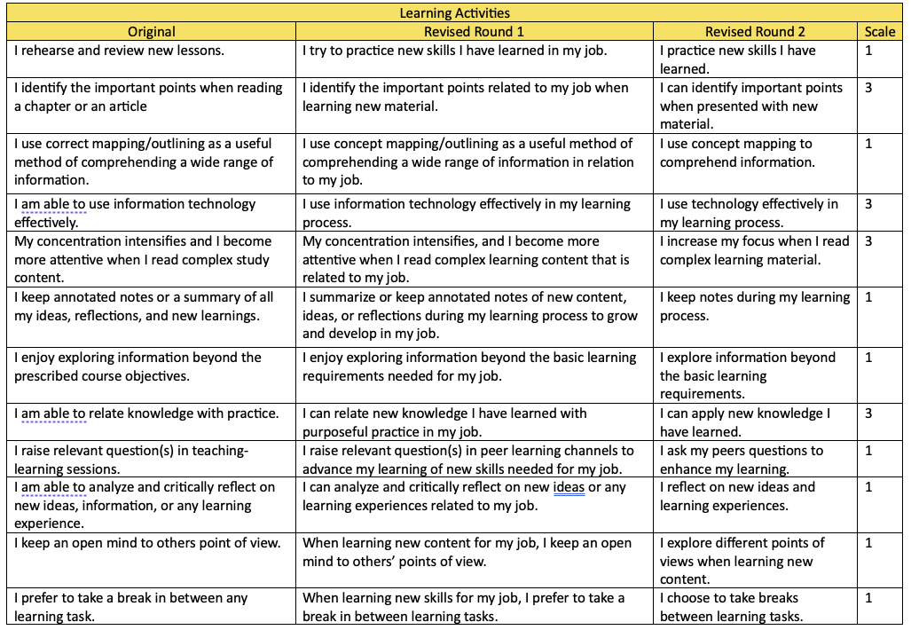
1
2
3
4
5
6
7
8

Slide 16
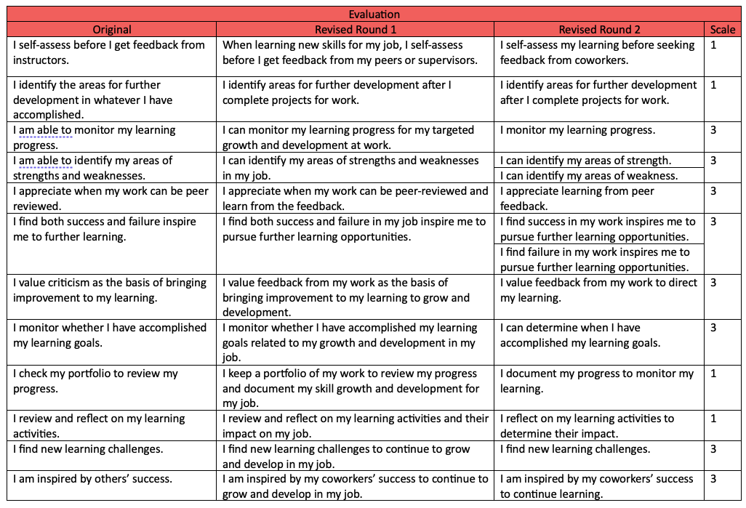
1
2
3
4
5
6
7
8

Slide 17
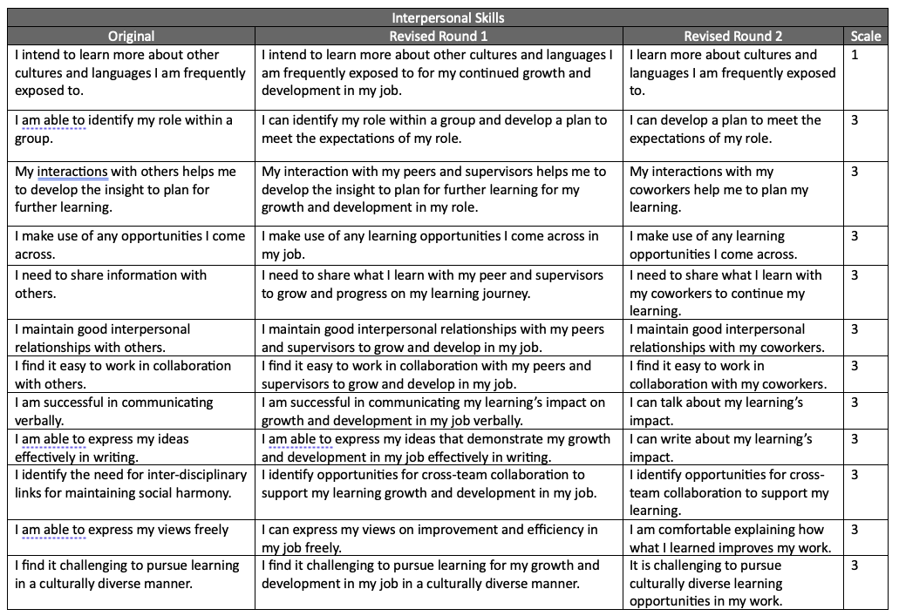
1
2
3
4
5
6
7
8

